Slide 1

Predicting Movie Gross 2021
By Boone Tison and Jackson King

Slide 2
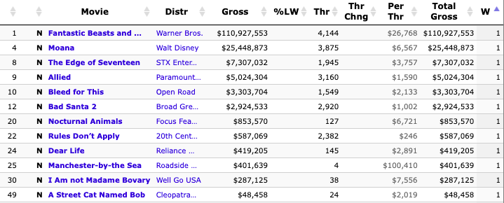
Data Collection
From the-numbers.com and IMDB
All movies released after Thanksgiving week over the last 10 years
2010-2019
Releases: 2016

Slide 3
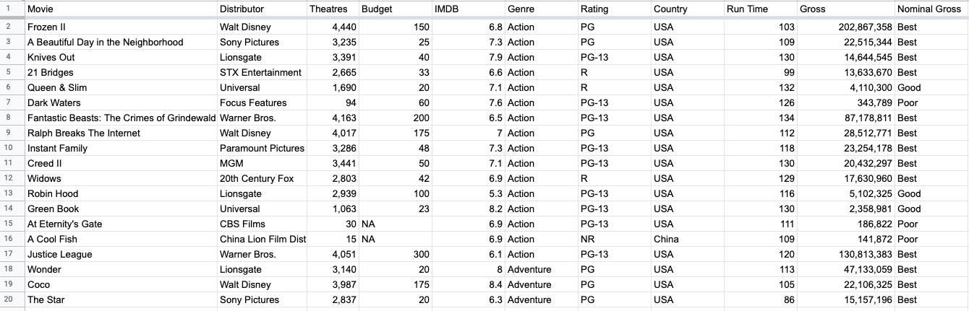
Training Data
Attributes: Movie, Distributor, Theaters (#), Budget ($ Millions), Genre, IMDB Rating, Country, Run Time (minutes), gross profit ($), and nominal gross profit

Slide 4
Testing Data
6 movies released November 24 - December 2
Testing Attributes: Distributor, theaters, budget, IMDB rating, genre, rating, country, run time, gross profit, nominal gross
3 released in over 2,500 US theaters
2 released in 4 US theaters
Movies from the USA, Germany, India, and Canada
Minimum Gross | $5,551 (Writing With Fire)
Maximum Gross | $45,220,641 (Encanto)

Slide 5
Classification Models
Nearest Neighbor: Classification
Neighborhoods of N = 2 and N = 3
Class attribute: nominal gross profit (Worst, Poor, Good, Best)
Decision Trees
Built using Entropy
Class attribute: nominal gross profit (Worst, Poor, Good, Best)

Slide 6
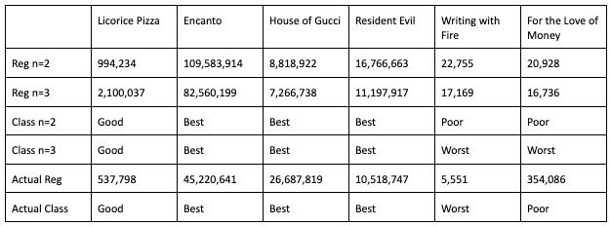
Nearest Neighbor: Classification
Nearest neighbor classification and regression table

Slide 7
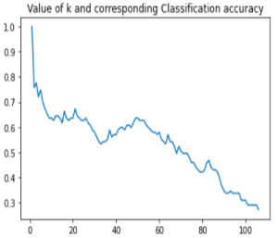
Confusion Matrix and k Value
N = 2 N = 3
N = 3 produced best models
Best | [3110]
Good | [0100]
Poor | [0010]
Worst | [0010]
Best | [3 0 0 0]
Good | [0 1 0 0]
Poor | [0 0 0 1]
Best | [0 0 0 1]

Slide 8
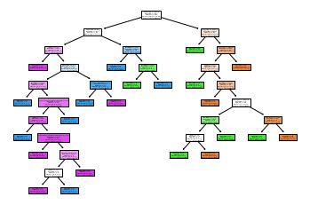
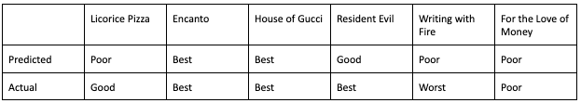
Decision Tree
Splits off of entropy
→ 22 leaves
Overall 4/6 accuracy

Slide 9
Regression Models
Linear Regression
Nearest Neighbor: Regression
Neural Network: Regression

Slide 10
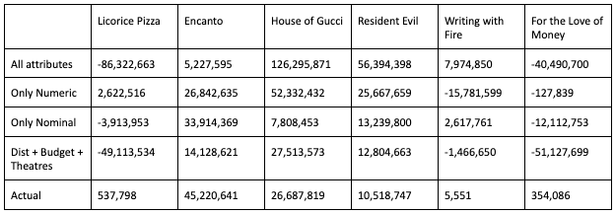
Linear Regression
All attributes regression model used | R-Squared: 0.741 | MAE: 53,495,216.21
Only original numeric attributes | R-Squared: 0.459 | MAE: 12,890,887.66
Only original nominal attributes | R-Squared: 0.539 | MAE: 8,769,582.03
Feature selected attributes | R-Squared: 0.666 | MAE: 22,771,501.76

Slide 11
Nearest Neighbor: Regression
Nearest neighbor classification and regression table
Nearest neighbor classification and regression table

Slide 12
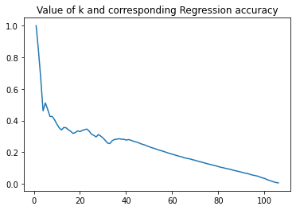
MAE and k Value
N = 2 | MAE: 15,244,480.75
N = 3 | MAE: 9,921,836.05

Slide 13
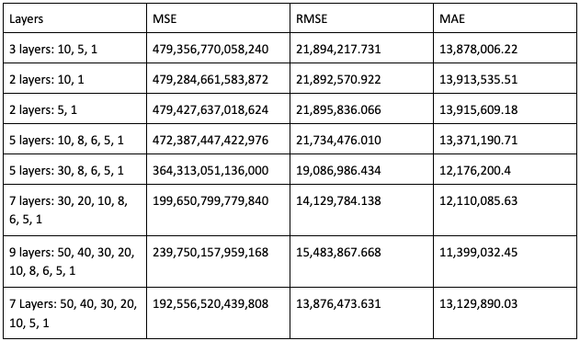
Neural Networks: Regression

Slide 14
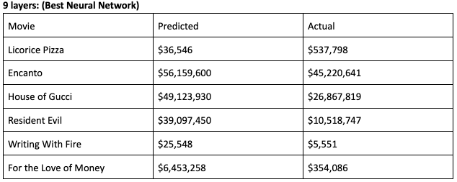
Best Neural Network
Has 9 layers
Input layer = 50
Hidden layers of 40, 30, 20, 10, 8, 6, 5
Output layer = 1

Slide 15
Best Models
Classification:
Nearest Neighbor
Performed for both N = 2 and N = 3 with 5/6 accuracy
Errors caused possibly by class attribute values (gross profit) being near the predicted discretized bucket
Regression:
Nearest Neighbor
N = 3
Lowest overall mean absolute error
MAE = 9,921,836.05

